Slide 1
TYPESCRIPT
BY TELYACHY VADYM

Slide 2

WHAT IS TYPESCRIPT?
TypeScript is an open-source language which builds on JavaScript, one of the world’s most used tools, by adding static type definitions.
Types provide a way to describe the shape of an object, providing better documentation, and allowing TypeScript to validate that your code is working correctly.
TypeScript is a layer because you can write TypeScript code in your editor. After a compilation all that TypeScript stuff is gone and you're left with plain, simple JavaScript.
Writing types can be optional in TypeScript, because type inference allows you to get a lot of power without writing additional code.

Slide 3
WHY TO USE TS?
The benefits of TypeScript include −
Compilation − JavaScript is an interpreted language. Hence, it needs to be run to test that it is valid. It means you write all the codes just to find no output, in case there is an error. Hence, you have to spend hours trying to find bugs in the code. The TypeScript transpiler provides the error-checking feature. TypeScript will compile the code and generate compilation errors, if it finds some sort of syntax errors. This helps to highlight errors before the script is run.
Strong Static Typing − JavaScript is not strongly typed. TypeScript comes with an optional static typing and type inference system through the TLS (TypeScript Language Service). The type of a variable, declared with no type, may be inferred by the TLS based on its value.
TypeScript supports type definitions for existing JavaScript libraries. TypeScript Definition file (with .d.ts extension) provides definition for external JavaScript libraries. Hence, TypeScript code can contain these libraries.
TypeScript supports Object Oriented Programming concepts like classes, interfaces, inheritance, etc.

Slide 4
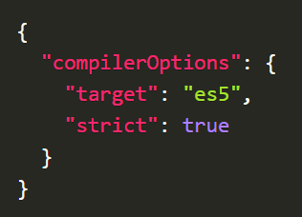
ENVIROMENT SETUP
To start codding it TypeScript do these several steps:
-Install TS globally: npm install -g typescript
-Create new node project: npm init –y
-Add typescript to our project: npm i typescript --save-dev
-Config node scripts to easy start: "scripts": { "tsc": "tsc" },
-Init configuration file for TS: npm run tsc -- --init
For easy start replace all in TS config file with this:
Ok, now write your code and use npm run tsc
command to compile your awesome code!

Slide 5
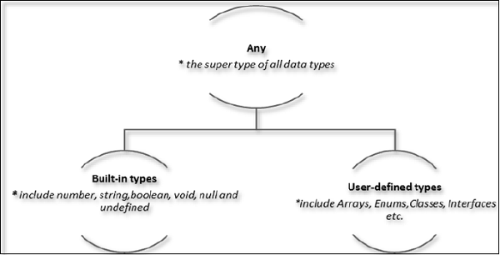
TYPESCRIPT TYPESCRIPT
The Type System represents the different types of values supported by the language. The Type System checks the validity of the supplied values, before they are stored or manipulated by the program. This ensures that the code behaves as expected. The Type System further allows for richer code hinting and automated documentation too.

Slide 6
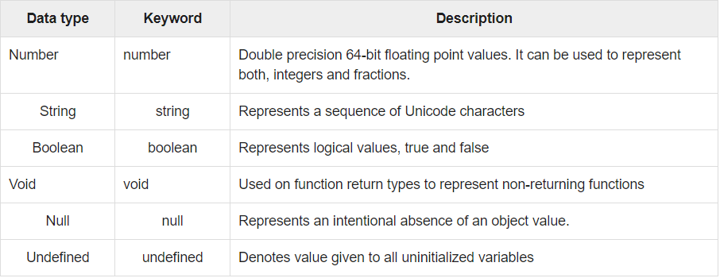
TYPESCRIPT TYPESCRIPT
ANY
The any data type is the super type of all types in TypeScript. It denotes a dynamic type. Using the any type is equivalent to opting out of type checking for a variable.
BUILD IN TYPES
The following table illustrates all the built-in types in TypeScript.
Note − There is no integer type in TypeScript and JavaScript.
USER DEFINED TYPES
User-defined types include Enumerations (enums), classes, interfaces, arrays, and tuple. These are discussed in detail in the later slides.

Slide 7
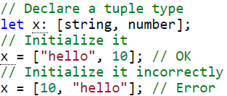
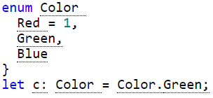
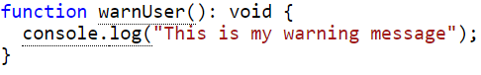
TYPESCRIPT TYPESCRIPT
TUPLE
Tuple types allow you to express an array with a fixed number of elements whose types are known, but need not be the same. When accessing an element with a known index, the correct type is retrieved.
ENUM
A helpful addition to the standard set of datatypes from JavaScript is the enum. As in languages like C#, an enum is a way of giving more friendly names to sets of numeric values.
VOID
void is a little like the opposite of any: the absence of having any type at all. You may commonly see this as the return type of functions that do not return a value

Slide 8
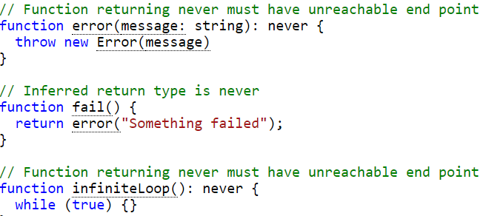
NEVER
The never type represents the type of values that never occur. For instance, never is the return type for a function expression or an arrow function expression that always throws an exception or one that never returns; Variables also acquire the type never when narrowed by any type guards that can never be true.
The never type is a subtype of, and assignable to, every type; however, no type is a subtype of, or assignable to, never (except never itself). Even any isn’t assignable to never.

Slide 9
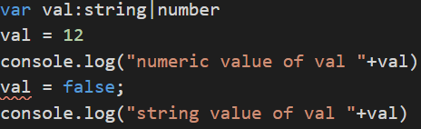
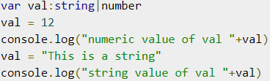
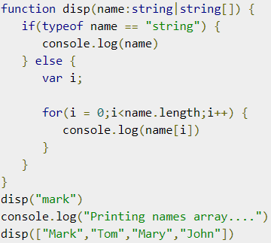
UNIONS
UNION
TypeScript 1.4 gives programs the ability to combine one or two types. Union types are a powerful way to express a value that can be one of the several types. Two or more data types are combined using the pipe symbol (|) to denote a Union Type.
In other words, a union type is written as a sequence of types separated by vertical bars.
Also you can use unions in functions, to add some more polymorphism to your code.

Slide 10
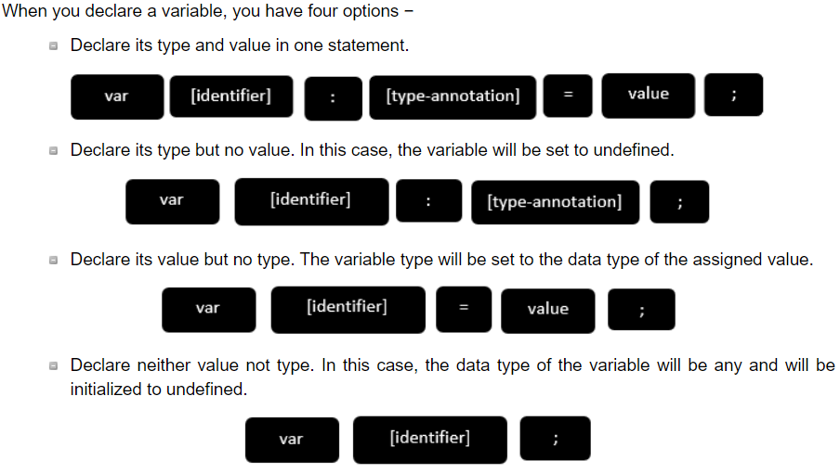
VARIABLES DECLARATION IN TS
Variables in TS must follow JS naming rules.
var name:string = ”mary” ← string,”mary”
var name:string; ← string,undefined
var name = ”mary” ← string*,”mary”
var name; ← any,undefined
NOTE: TypeScript compiler will generate errors, if we attempt to assign a value to a variable that is not of the same type.
var num:number = "hello"
// will result in a compilation error

Slide 11
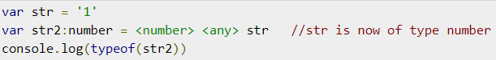
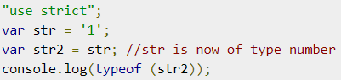
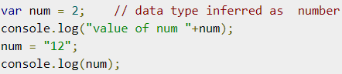
TYPE ASSERTION IN TS
INFERRED TYPING IN TS
TypeScript allows changing a variable from one type to another. TypeScript refers to this process as Type Assertion. The syntax is to put the target type between < > symbols and place it in front of the variable or expression.
On compiling we will get next code:
And str2 will be string, because “type assertions” are purely a compile time construct and a way for you to provide hints to the compiler on how you want your code to be analyzed.
TypeScript encourages declaring a variable without a type. In such cases, the compiler will determine the type of the variable on the basis of the value assigned to it. TypeScript will find the first usage of the variable within the code, determine the type to which it has been initially set and then assume the same type for this variable in the rest of your code block.
On 3rd line compiler will thrown an error:

Slide 12
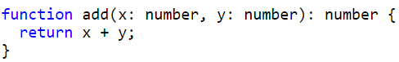
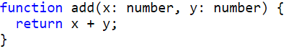
FUNCTIONS IN TS
Functions are the building blocks of readable, maintainable, and reusable code. A function is a set of statements to perform a specific task. Functions organize the program into logical blocks of code. Once defined, functions may be called to access code. This makes the code reusable.
In TypeScript a function declaration tells the compiler about a function's name, return type, and parameters. A function definition provides the actual body of the function.
We can add types to each of the parameters and then to the function itself to add a return type. TypeScript can figure the return type out by looking at the return statements, so we can also optionally leave this off in many cases.
==

Slide 13
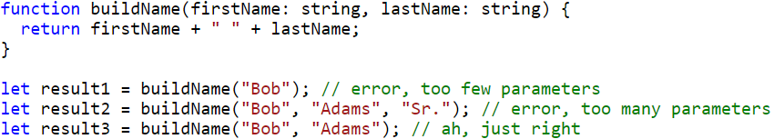
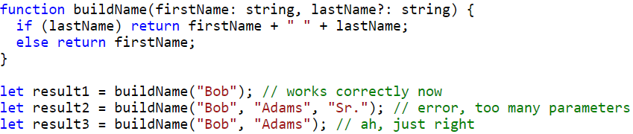
FUNCTIONS IN TS
In TypeScript you cant just add as many parameters, as you want:
In JavaScript, every parameter is optional, and users may leave them off as they see fit. When they do, their value is undefined. We can get this functionality in TypeScript by adding a ? to the end of parameters we want to be optional. For example, let’s say we want the last name parameter from above to be optional:
← That’s how overload work in TS

Slide 14
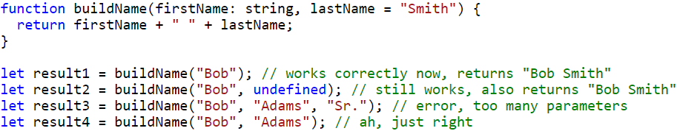
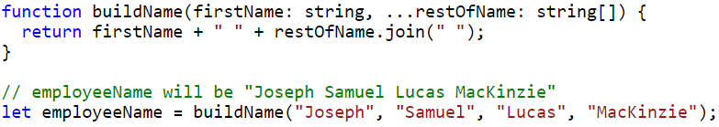
FUNCTIONS IN TS
In TypeScript, we can also set a value that a parameter will be assigned if the user does not provide one, or if the user passes undefined in its place. These are called default-initialized parameters.
But be careful, if you will call buildName(undefined,”Adams”), TS will throw error.
REST
In JavaScript, you can work with the arguments directly using the arguments variable that is visible inside every function body.
In TypeScript, you can gather these arguments together into a variable:

Slide 15
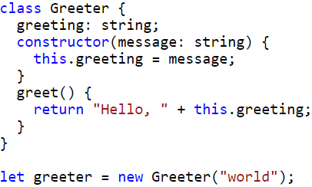

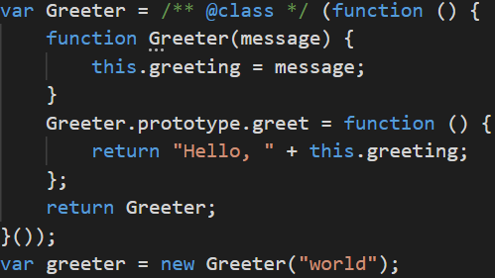
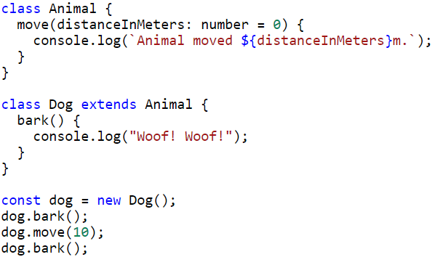
TYPESCRIPT AND OOP
Traditional JavaScript uses functions and prototype-based inheritance to build up reusable components, but this may feel a bit awkward to programmers more comfortable with an object-oriented approach, where classes inherit functionality and objects are built from these classes.
In TypeScript, we can use common object-oriented patterns. One of the most fundamental patterns in class-based programming is being able to extend existing classes to create new ones.
HINT
/** */ ← That’s static typeckeck

Slide 16
MODIFIERS IN TS
Like others programming languages, TypeScript supports access modifiers at the class level. TypeScript supports three access modifiers - public, private, and protected.
Public - By default, members (properties and methods) of TypeScript class are public - so you don’t need to prefix members with the public keyword. Public members are accessible everywhere without restrictions
Private - A private member cannot be accessed outside of its containing class. Private members can be accessed only within the class.
Protected - A protected member cannot be accessed outside of its containing class. Protected members can be accessed only within the class and by the instance of its sub/child class.
Readonly - TypeScript supports readonly modifiers on property level by using the readonly keyword. The Readonly properties must be initialized at their declaration or in the constructor.
In compiled JavaScript code, there will be no such types of restriction on the members.

Slide 17
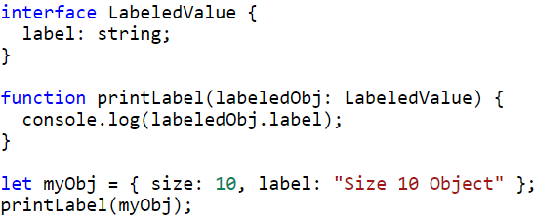
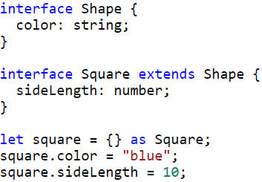
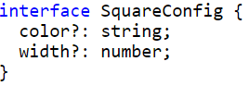
INTERFACES
An interface is a syntactical contract that an entity should conform to. In other words, an interface defines the syntax that any entity must adhere to.
Interfaces define properties, methods, and events, which are the members of the interface. Interfaces contain only the declaration of the members. It is the responsibility of the deriving class to define the members. It often helps in providing a standard structure that the deriving classes would follow.
Not all properties of an interface may be required. Some exist under certain conditions or may not be there at all. These optional properties are popular when creating patterns like “option bags” where you pass an object to a function that only has a couple of properties filled in.

Slide 18
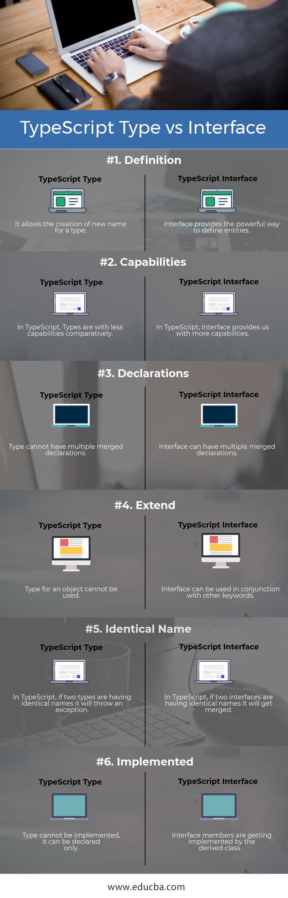
T Y P E S

Slide 19
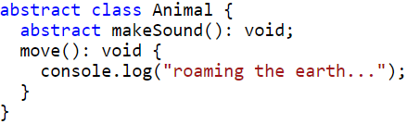
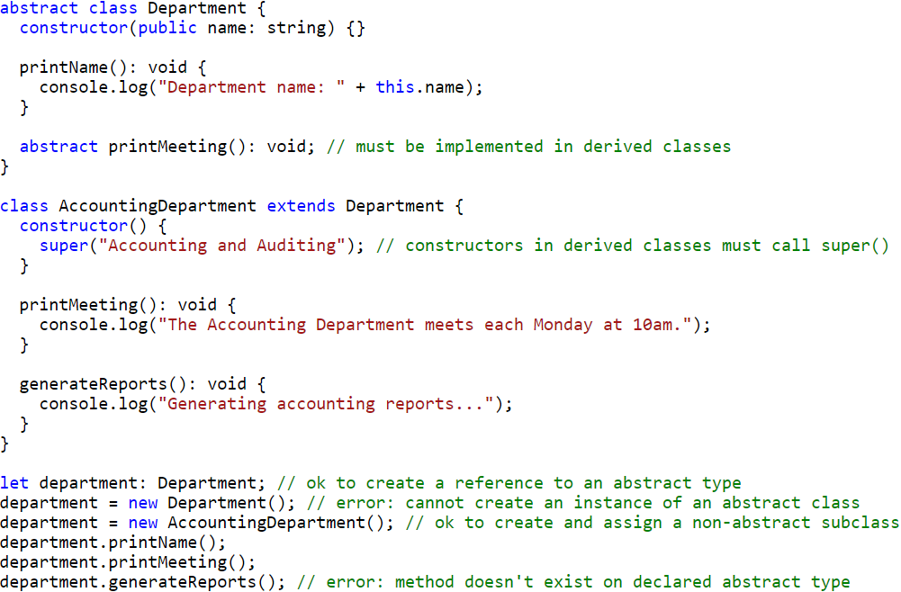
ABSTRACT CLASSES
Abstract classes are base classes from which other classes may be derived. They may not be instantiated directly. Unlike an interface, an abstract class may contain implementation details for its members. The abstract keyword is used to define abstract classes as well as abstract methods within an abstract class.
Methods within an abstract class that are marked as abstract do not contain an implementation and must be implemented in derived classes. Abstract methods share a similar syntax to interface methods. Both define the signature of a method without including a method body. However, abstract methods must include the abstract keyword and may optionally include access modifiers.

Slide 20
LINKS
https://www.typescriptlang.org/
https://www.valentinog.com/blog/typescript/
https://www.tutorialspoint.com/typescript/index.htm
https://medium.com/
https://www.educba.com/typescript-type-vs-interface/

Slide 21
